Slide 1


For Beginner
By :- RAHUL JOGRANA
www.dotnetlab.in
www.aspnetinhindi.blogspot.com
Twitter:- @thejograna
Github:- github.com/rahuljograna
Part 15 loading components in ionic

Slide 2

Loading in ionic
The Loading component is an overlay that prevents user interaction while indicating activity. By default, it shows a spinner based on the mode. Dynamic content can be passed and displayed with the spinner. The spinner can be hidden or customized to use several predefined options. The loading indicator is presented on top of other content even during navigation.

Slide 3
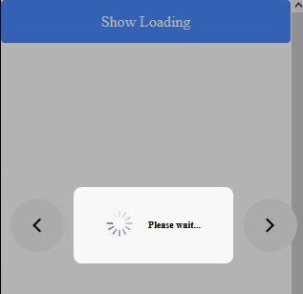
Loading in ionic

Slide 4
Let’s start

Slide 5
To learn new Technology along with Example like
ASP.NET, ASP.NET MVC, AngularJS, ASP.NET Web API
From Beginners visit my Youtube channel and steps and Source code is
Available on My Blog and Web site
To Get notification for new updates Subscribe my YOUTUBE Channel.
Source Code :- http://aspnetinhindi.blogspot.com
Website :- http://www.dotnetlab.in
Github :- https://github.com/rahuljograna
Twitter :- twitter.com/thejograna
Mail :- rahuljograna007@gmail.com
WhatsApp Number :- 9426585554

Slide 6
To Develop Application
Contact me
Mail me : rahuljograna007@gmail.com
Mobile : +91 9426585554
whatsApp : +91 9426585554

